Slide 1
NSF FMSG Project Kick-Off Meeting
Haoran Lin, Layla Mravac, AJ Bradshaw, Shuolong Yang (PME)
Yuxin Chen (CS)

Slide 2
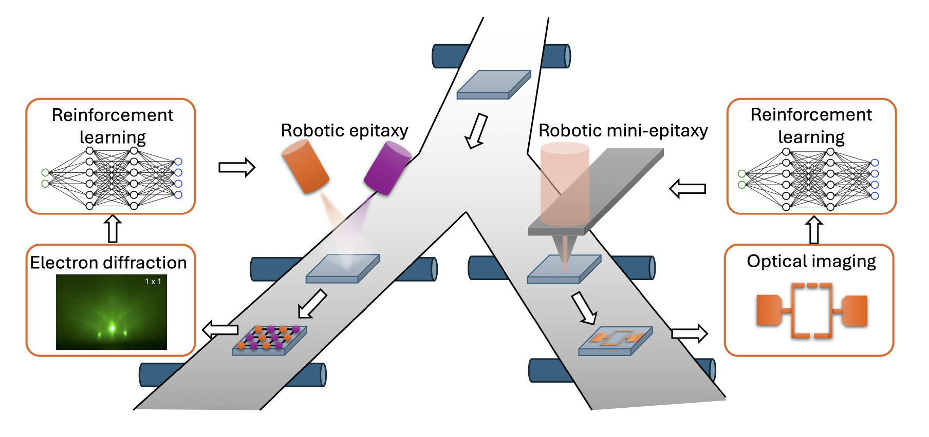
Overall Goals
Build the RHEED data base for FeSe growth for structured reinforcement learning
Design structured deep reinforcement learning models to guide self-learning robotic epitaxy – Question: how much hardware automation will we do?
Develop preliminary reinforcement learning models for real-time control in robotic mini-MBE

Slide 3
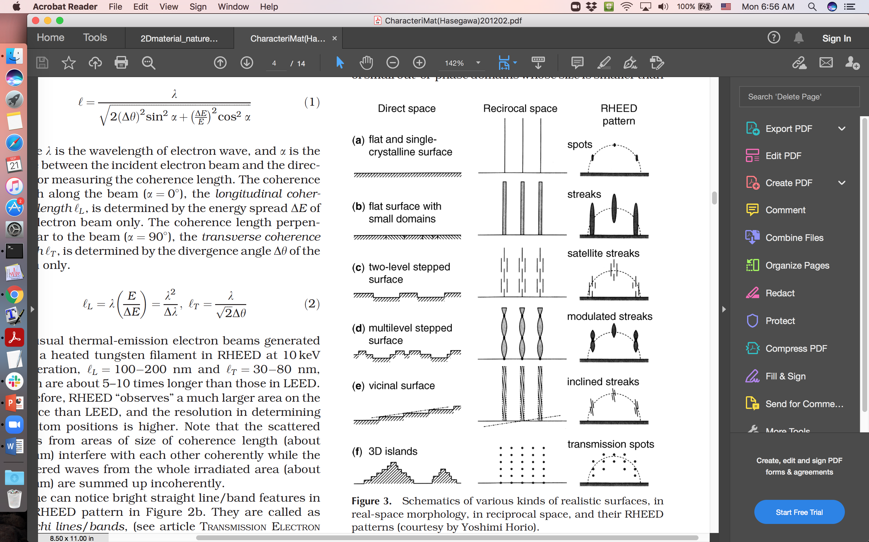
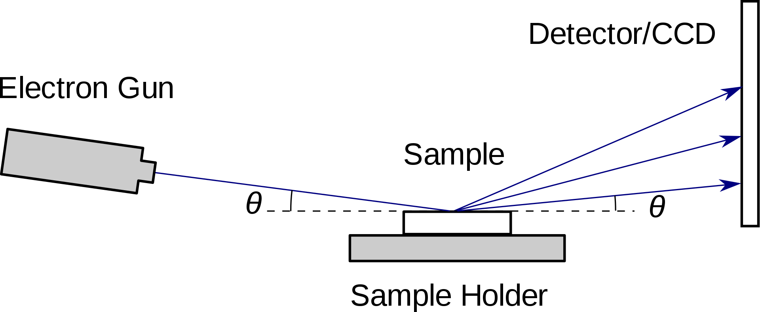
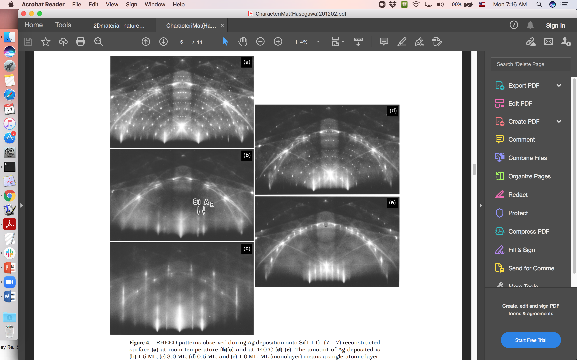
Goal 1: Build the RHEED data base for FeSe growth
In situ reflection high energy electron diffraction (RHEED)
Si(111)-(7x7)
1.5ML Ag on Si(111)-(7x7)
3ML Ag on Si(111)-(7x7)
Hasegawa Characterization of materials (2012)

Slide 4
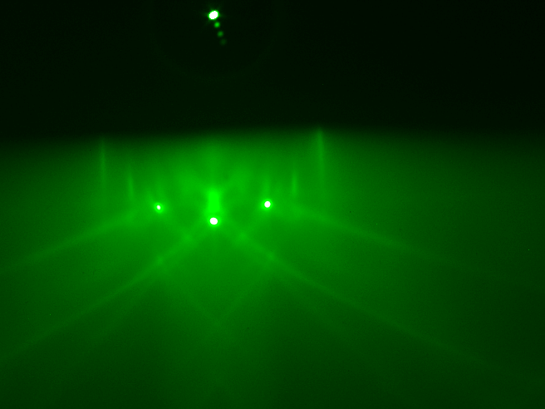
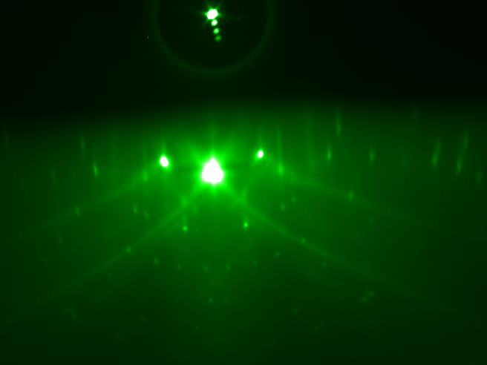
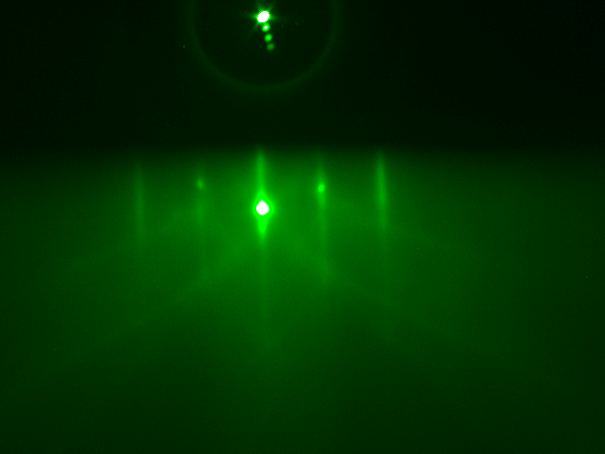
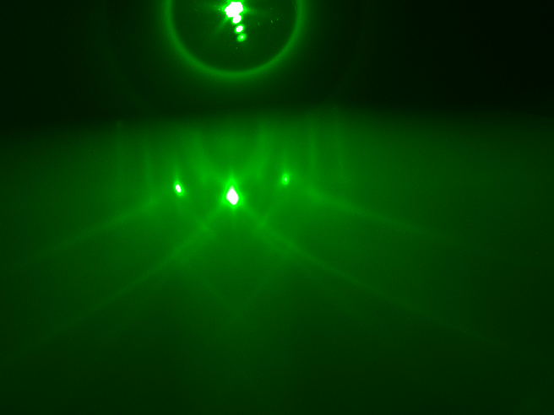
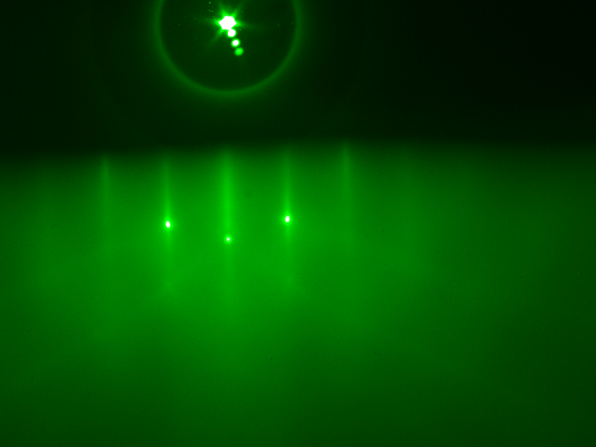
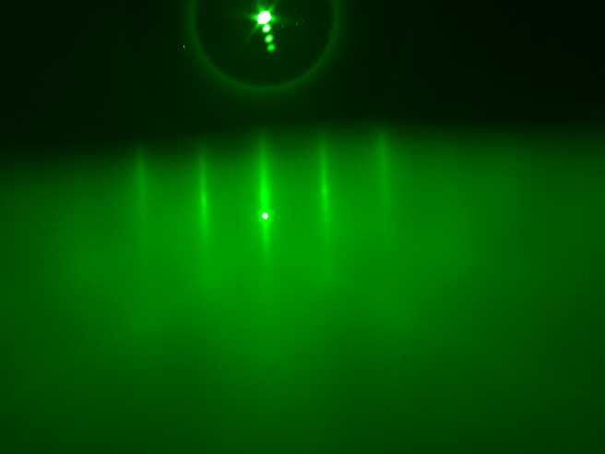
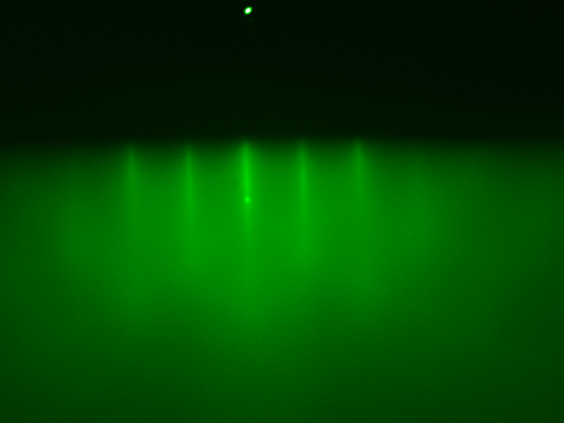
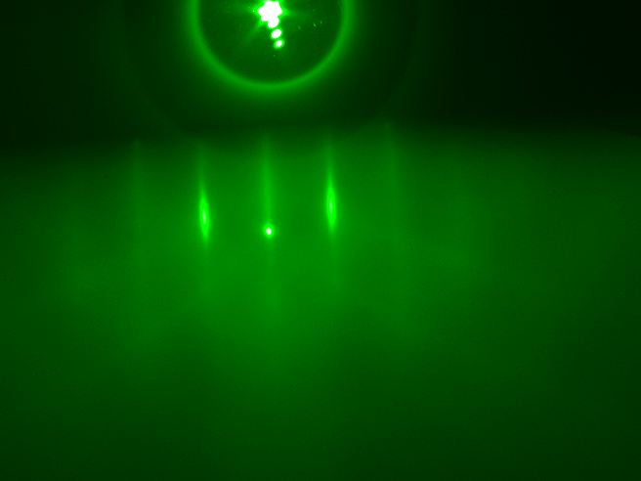
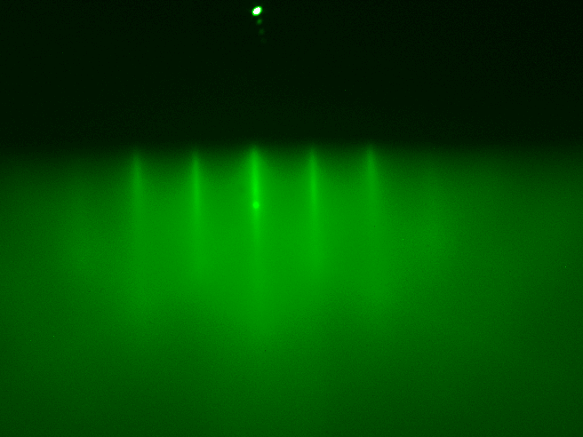
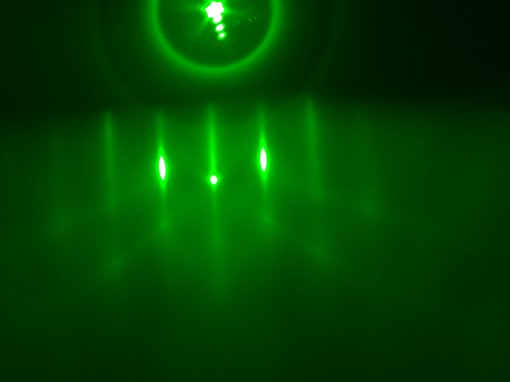
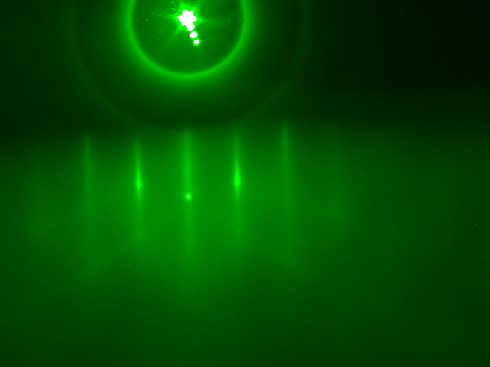
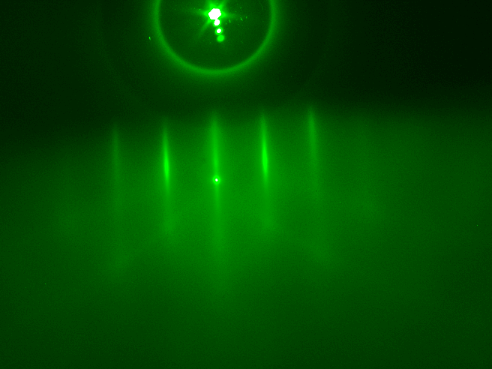
Sample 1
Sample 2
Sample 3
Sample 4
ISTO (400C- 600C-Themal couple 5h)
ISTO (400C 10h/600C 3h)
ISTO (400C 10h/600C 3h)
Nb-STO (1000C-pyrometer 2h)
1180/150 (335C 6min)
1180/150 (355C 5min)
1180/150 (374C 6min)
1180/150 (425C 6min)
Annealed (335C 12h)
Annealed (355C 7h)
Annealed (374C 7h)
Annealed (425C 12h)
Bad film
Okay film
Bad film
Good film

Slide 5
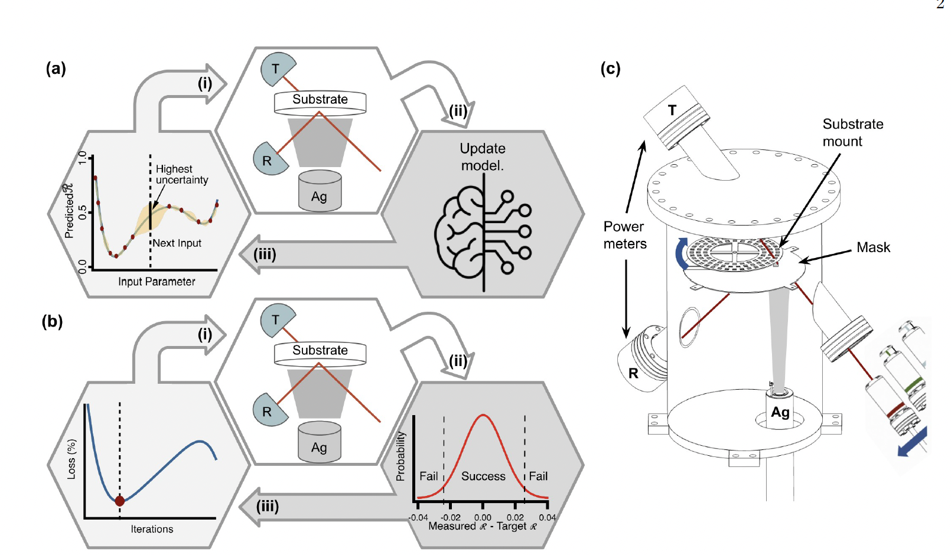
Goal 2: Design structured deep reinforcement learning models to guide self-learning robotic epitaxy
We have an existing robotic epitaxy system, but only for simple materials – silver
To fabricate FeSe, we will need $100k more investment, which we don’t have now.
Maybe develop a software for real-time guidance, but no hardware automation – a chat bot?

Slide 6
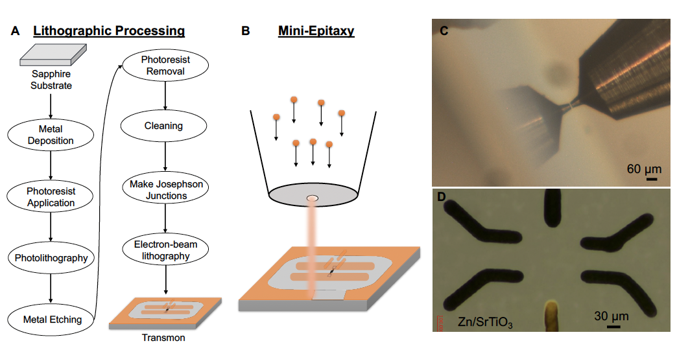
Goal 3: Develop preliminary reinforcement learning models for real-time control in robotic mini-MBE
A lot of hardware development still needs to be done, but expecting some good results in the next 0.5 years.
What characterization tools will we use?

Slide 7
Immediate tasks
Establish monthly meetings
Establish a shared data repository
Break down the MBE process into smaller tasks for RL

